Slide 1
Agile Techniques: Scrum
Dr Steffen Zschaler
Notes:
<CTRL-SHIFT-HOME><CTRL-SHIFT-2>
Welcome.
We’ve seen the organised chaos that is Kanban. But as the size and complexity of software development projects grows, we need to be a bit more organised. In particular, we need a more structured way for prioritisation and focused work with a target deadline of some kind.
In this video, I will introduce you to Scrum, one example of an agile software development process that provides some structure on top of user stories and Kanban boards.

Slide 2
Scrum
Scrum focus is on managing iterative development rather than specific agile practices
Three phases:
Initial phase (Sprint 0)
Outline planning phase
Establish general objectives for project and design software architecture
Some people argue against this (because “not agile”)
A series of “sprints”
Each sprint develops an increment of the system
Project closure
Wraps up project
Complete required documentation
Lessons learned from project
Notes:
The focus of Scrum is not on any particular agile programming techniques, but on how to best manage iterative development as a whole.
A Scrum project proceeds roughly in three phases:
In a first phase, sometimes called Sprint 0, the team undertakes some general outline planning, and establishes the general objectives for a project and the software architecture.
This is followed by the core phase of the project, in which the team develops the software in a series of so-called “sprints”, where each spring delivers an increment of the software system.
Finally, at some point the project ends, providing relevant documentation and learning lessons for future projects.
Some people argue against Sprint 0, as they feel that such planning is, fundamentally, not “agile”. However, increasingly, there is recognition that a certain amount of planning is required for any larger software project to be successful.

Slide 3
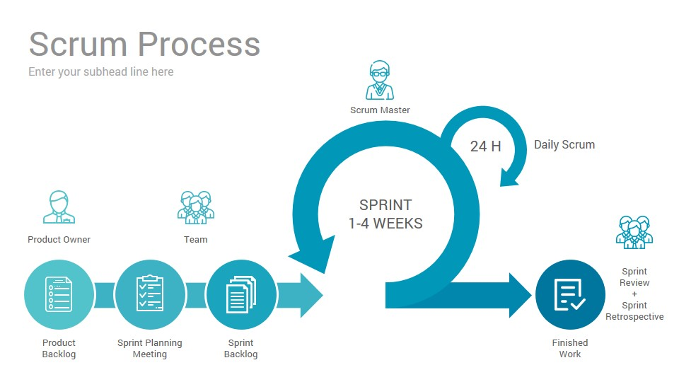
SCRUM – sprint cycles
Daily standup at SCRUM board
Burn down tasks
Monitor progress
From top of product backlog
what can be done in limited time
of one sprint?
Prioritised and refined
according to priority
Feed back into
next sprint planning
and product backlog
Absolute timebox
Notes:
We’ve already said that the key building block of a Scrum process is the so-called “sprint”. Let’s look at this in a bit more detail.
<CTRL-SHIFT-4>
Here, you can see an overview picture of the structure of a sprint.
<ANIMATE>
A product owner keeps a backlog of user stories.
The product owner is a customer representative and is the person in charge of making decisions about story priority and selection.
Together with the development team, the product owner agrees on how user stories should be broken down into tasks and how these tasks should be prioritised.
<ANIMATE>
At the start of a sprint, the development team, together with the product owner, hold a sprint planning meeting, during which they select a subset of the stories and tasks on the product backlog (those with the highest priority) into a sprint backlog of tasks to be completed in the upcoming sprint. The team aim to ensure that the sprint backlog will be filled sensibly, taking on neither too few nor too many tasks for the upcoming sprint.
The sprint itself is then a period of 1 to 4 weeks (most typically around 2 weeks), during which the developers pick a card from the sprint backlog and work on it until it has been completed, then pick the next card.
<ANIMATE>
This is typically facilitated with a Kanban board (sometimes called the Scrum board).
Every day, the team start with a “standup” meeting, where every member of the team briefly reports on progress, blockers, and plans for the upcoming day. This helps keep the whole team informed of what is going on, but is not the place to resolve any issues.
Progress is tracked via cards on the Kanban board and also using a so-called burn-down metric, showing the speed at which tasks from the sprint backlog are being completed.
<ANIMATE>
The pre-agreed sprint duration is an absolute timebox. When the time is up, the sprint ends and the new version of the software is delivered to the customer.
Tasks that could not be completed in the sprint go back to the product backlog and will be reprioritised during the next sprint planning meeting.
<ANIMATE>
A sprint concludes with a sprint review and retrospective meeting, where lessons are learned and the next sprint is prepared.
<CTRL-SHIFT-2>

Slide 4
Scrum terminology
Development team
Self-organizing group of software developers
No more than 7 people
Responsible for developing software and other essential project documents
Sprint
Development iteration
Usually 2-4 weeks long and strictly time boxed
Potentially shippable product increment
Software increment delivered from a sprint
Should be in a finished state with no further work, such as testing, needed to incorporate it into the final product
Product backlog
List of items development team must tackle
Feature definitions, software requirements, user stories, descriptions of supplementary tasks
Notes:
There are a number of terms that are useful to know about when discussing Scrum:
<ANIMATE> The development team in Scrum is a small, self-organising group of software developers, typically no more than 7 people. They are the people responsible for developing the software and accompanying documentation.
<ANIMATE> A sprint is the term for a single development duration, which is typically around 2 weeks long and strictly timeboxed.
<ANIMATE> The increment delivered from a sprint is referred to as a “potentially shippable product increment” (quite a mouthful, ey?). This should be in a finished state, needing no further work including for documentation, testing, etc. As a result, it should be possible to integrate this increment into the final product directly at the end of the sprint (though that doesn’t always happen right away). In practice, Scrum teams can often be pushed to overload the sprint backlog and, as a result, some activities such as testing or documentation may not be completed at the end of the sprint, often leading to problems further downstream.
<ANIMATE> The product backlog is the list of user stories a team must tackle to deliver the complete product. This is the source from which tasks are selected for inclusion in the current sprint backlog.

Slide 5
Scrum terminology
Product owner
Individual whose job is to identify, prioritise and review product features or requirements
Can be a customer or product manager
Scrum
Daily brief meeting of the development team at Scrum board
Reviews progress and prioritizes work to be done that day
Identifies blockages, to be resolved by ScrumMaster
ScrumMaster
Responsible for ensuring Scrum process is followed
Guides team in the effective use of Scrum
Responsible for interfacing with rest of company and ensuring Scrum team is not diverted by outside interference
In Scrum world, in effect, a “Guru”. In practice, an experienced project manager ☺
Velocity
Number of tasks / cards that can be handled in a sprint
Notes:
The product owner is a representative of the customer whose job is to identify, prioritise, and review user stories on the product backlog. They “own” the backlog and their decision is final.
<ANIMATE> The term “scrum” refers to the daily standup meeting of the development team in front of the Kanban board. This provides a progress update and identifies external blockages, which then need to be resolved by the scrum master.
<ANIMATE> The scrum master is where things get a little mythological. In the pure practice, this is meant to be a sort-of “Scrum guru” who coaches and mentors the team through the process. In practice, this is effectively the team’s manager, whose responsibility includes some coaching and mentoring, but also requires shielding the team against external distraction and ensuring that the process is followed carefully.
<ANIMATE> The notion of velocity is very important for many Scrum teams as it measures the number of tasks / cards that can be handled in a sprint – a measure of the effectiveness of the team.

Slide 6
Scrum benefits
Product is broken into set of manageable and understandable chunks
Unstable requirements do not hold up progress
Customers see on-time delivery of increments
Customers gain feedback on how the product works
Trust between customers and developers is established
Whole team has visibility of everything
Improved team communication
Positive culture in which everyone expects project to succeed
Notes:
Scrum has many benefits over an XP-style of agile or, even, just the use of Kanban boards.
Most importantly, the sprints chunk the development process providing clear coherent focus for the team as a whole.
This means that there is some stability and requirements do not change constantly. Teams can focus on finishing a particular requirement in the knowledge that it won’t change halfway through their work.
At the same time, the duration of a sprint is short enough to maintain agility and responsiveness to change.
Customer see sustained on-time delivery of features and can provide feedback on the product. This establishes trust between customers and developers.
Standups and a physical Kanban board mean that the whole team have good visibility of their respective work. This improves team communication.
Overall, this continuous progress produces a positive expectation of project success, which helps drive the project forward.
---
Scrum is a good example of an agile software development process.
One thing you may have noticed is its focus on small teams, driven by the need for frictionless communication between all developers.
In the next video on KEATS, we are going to look at this aspect of agile development in particular and how it affects our ability to use agile development for large-scale projects.
<CTRL-SHIFT-END>

